Slide 1

WEB DESIGNING
Guide : Mr. ASHISH KUMAR SAHU
TEAM MEMBERS
B. Santosh Kumar 18BCE10081
P. Nile Krupa Sheel 18BCE10183
P.C.V.V. Mounish 18BCE10187
T. Mahesh 18BCE10280

Slide 2

WEB DESIGNING :
Web design encompasses many different skills and disciplines in the production and maintenance of websites. The different areas of web design include web graphic design; interface design; authoring, including standardized code and proprietary software; user experience design; and search engine optimization.

Slide 3
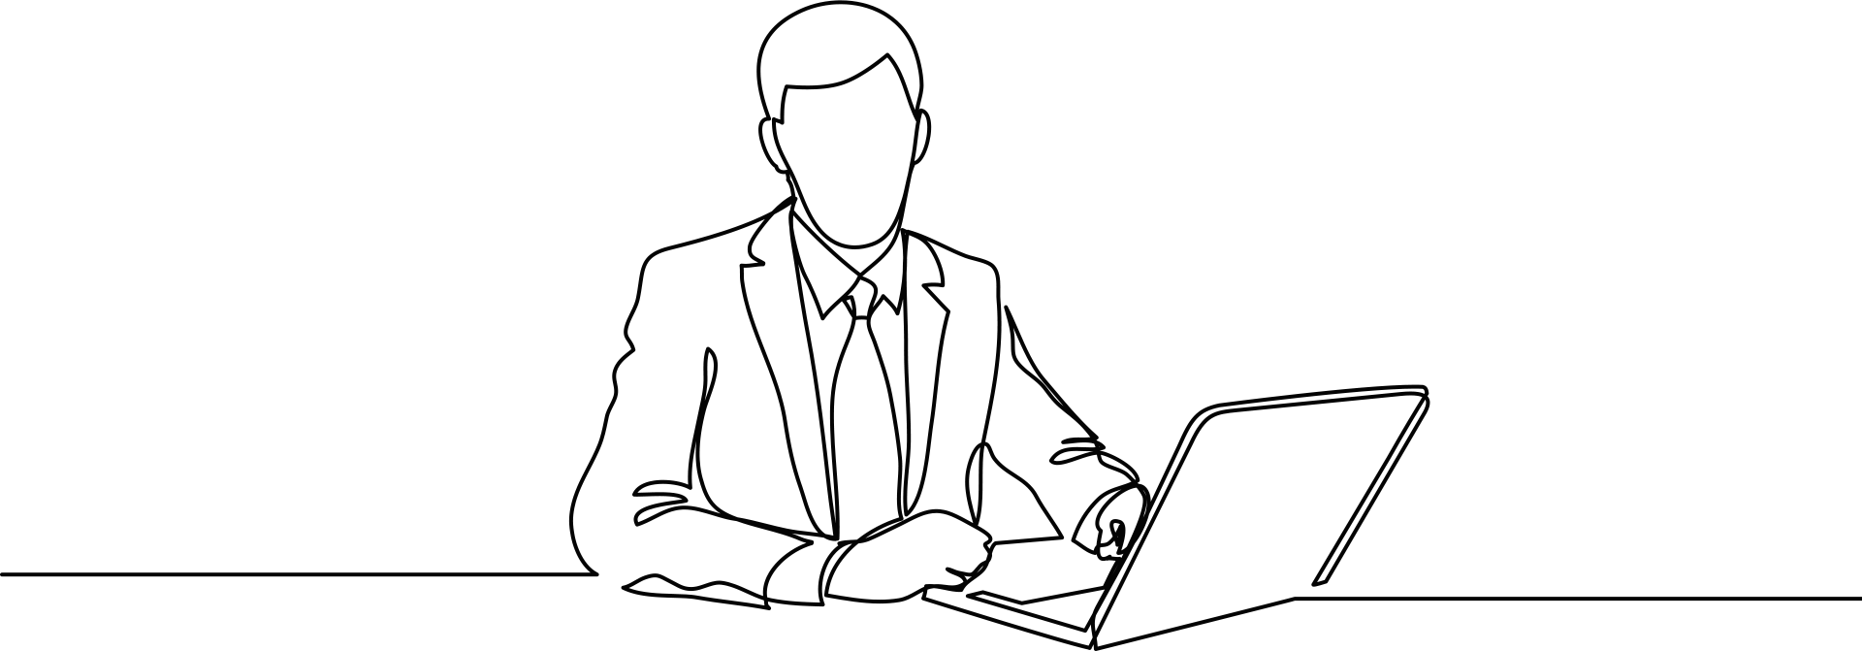
WEB DESIGNER:
A Web designer is someone who prepares content for the Web. This role is mainly related to the styling and layout of pages with content, including text and images. Web designers use many technologies but commonly rely on hypertext and hypermedia resources including HTML, CSS and additional Web design tools.

Slide 4

Project On : SUGGESTIONS IN VIT BHOPAL WEBSITE

Slide 5

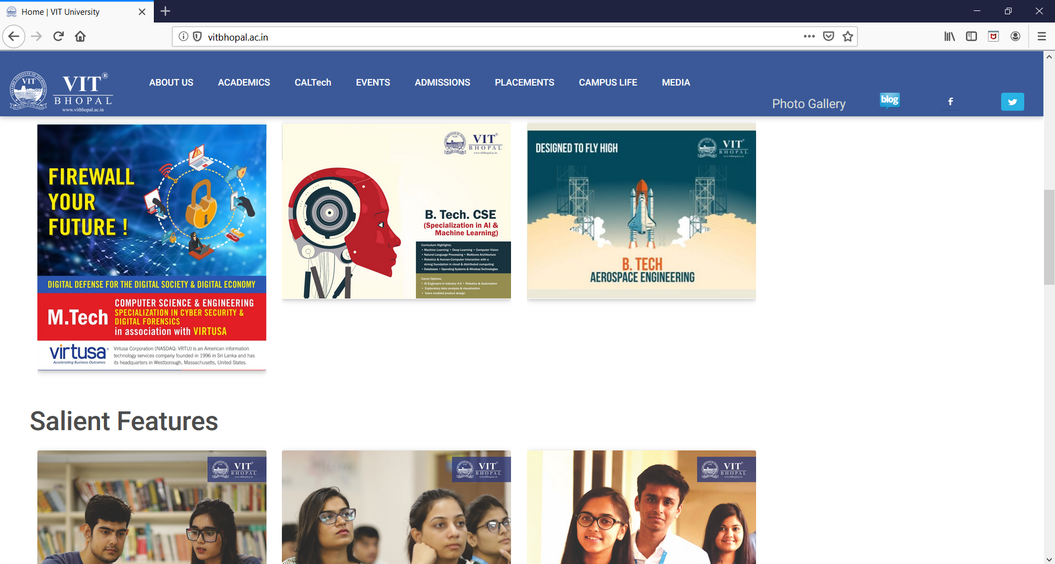
Suggestion 1 :
PROVIDING FACULTY DETAILS

Slide 6

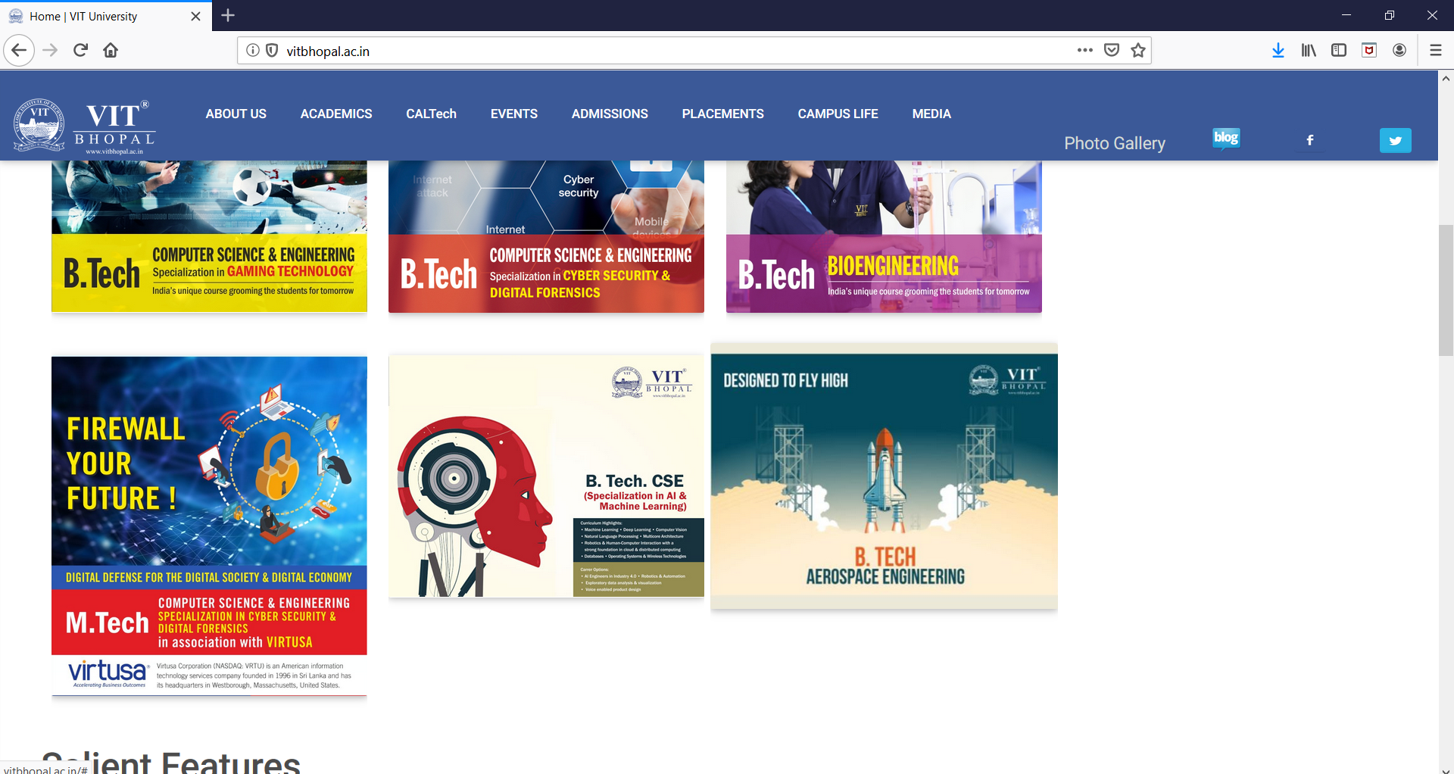
Suggestion 2 :
PROPER ARRANGEMENT OF CONTENT

Slide 7
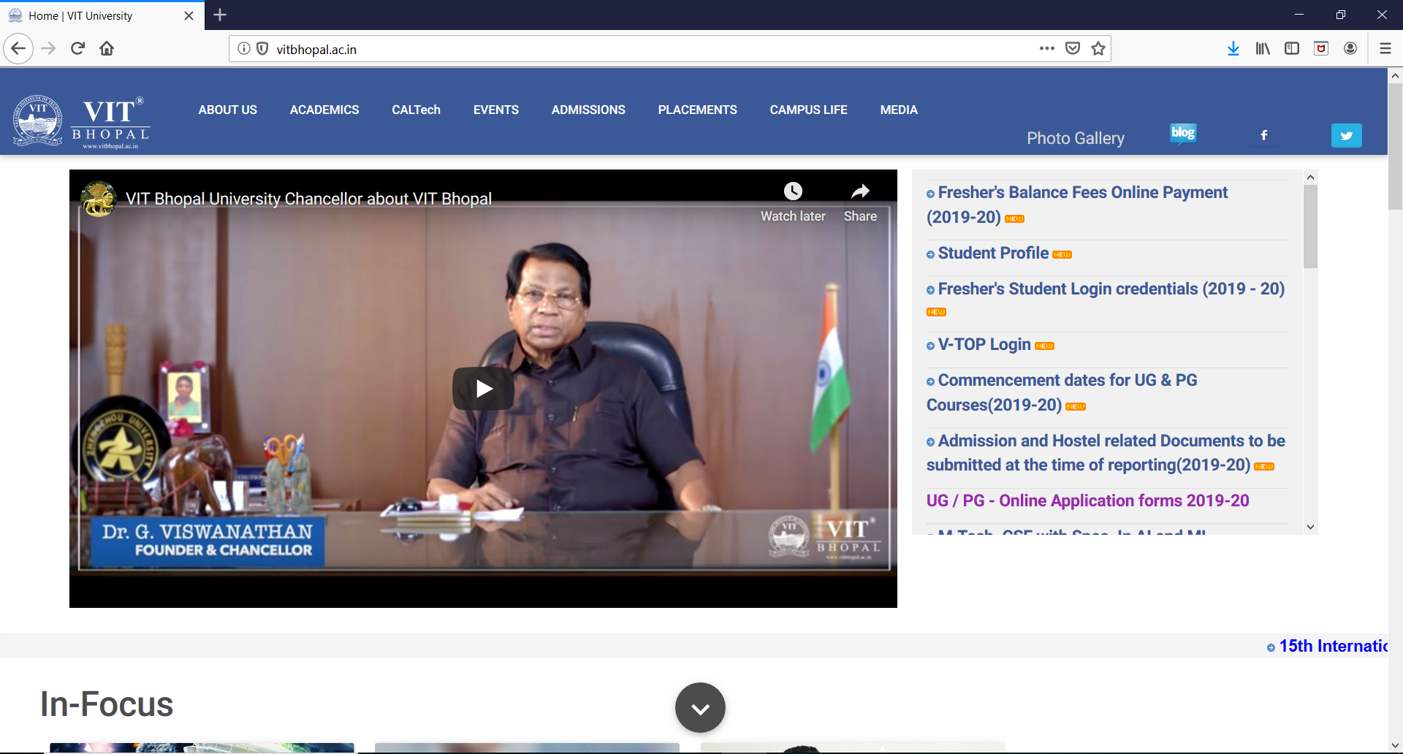
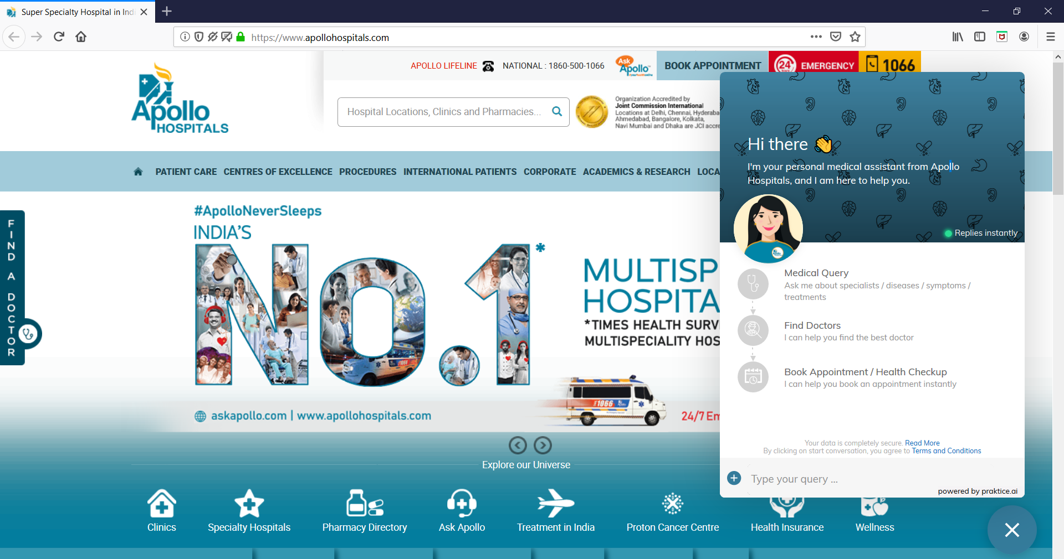

Suggestion 3:
CHAT POPUP

Slide 8

HARDWARE REQUIREMENT :
 | Windows requirements
Operating system | Windows 7 or later
Processor | Intel Pentium 4 or later
Memory | 2 GB minimum, 4 GB recommended
System requirements

Slide 9

SOFTWARE REQUIREMENT :
HTML : Hypertext Markup Language, the authoring language used to create documents on the World Wide Web.
CSS : Cascading Style Sheets is a stylesheet language used to describe the presentation of a document CSS describes how elements should be rendered on screen, on paper, in speech, or on other media.

Slide 10
Flowchart :
VIT BHOPAL
MENU
ARRANGEMENT OF ICONS
FACULTY CABINS
HELP
GROUND
FIRST
SECOND
THIRD
FOURTH
FIFTH
CHAT POPUP
BLOCK A | BLOCK B

Slide 11
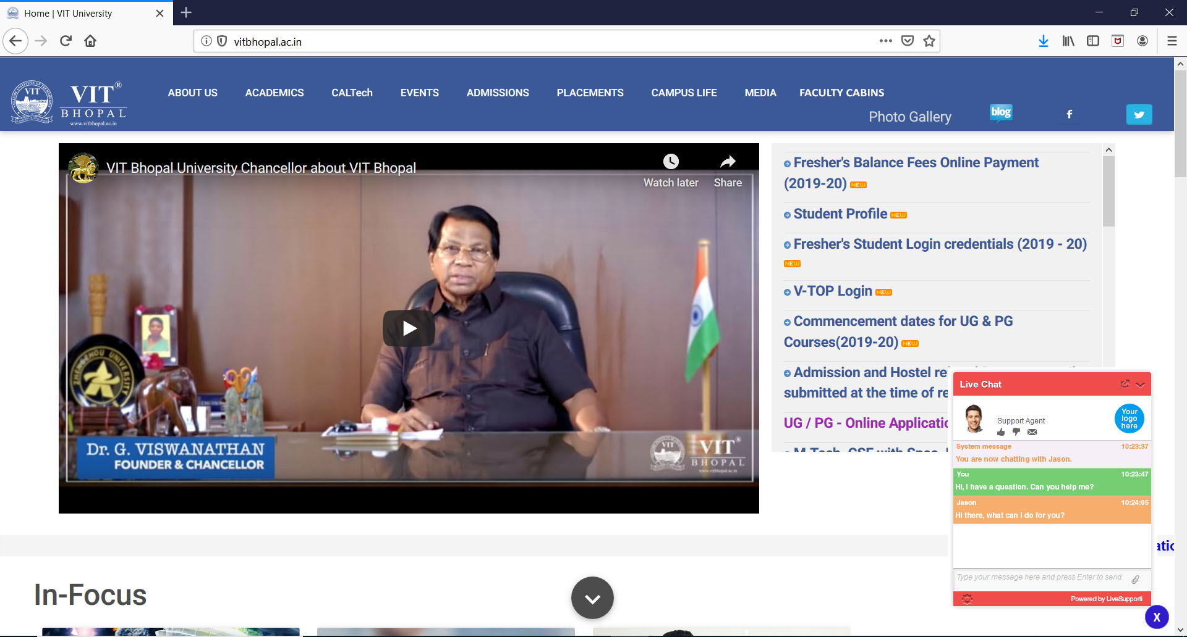
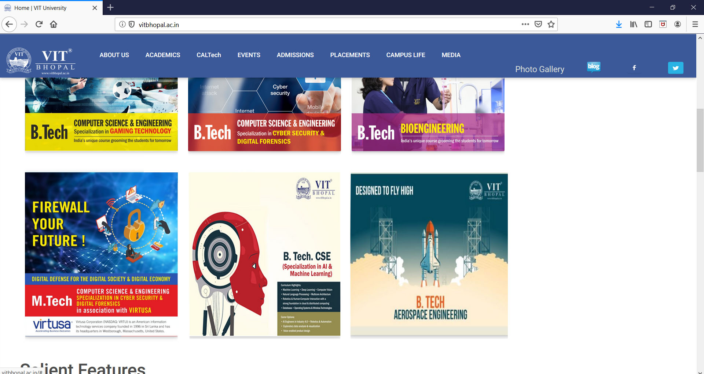
OVERALL SYSTEM:

Slide 12


